Slide 1
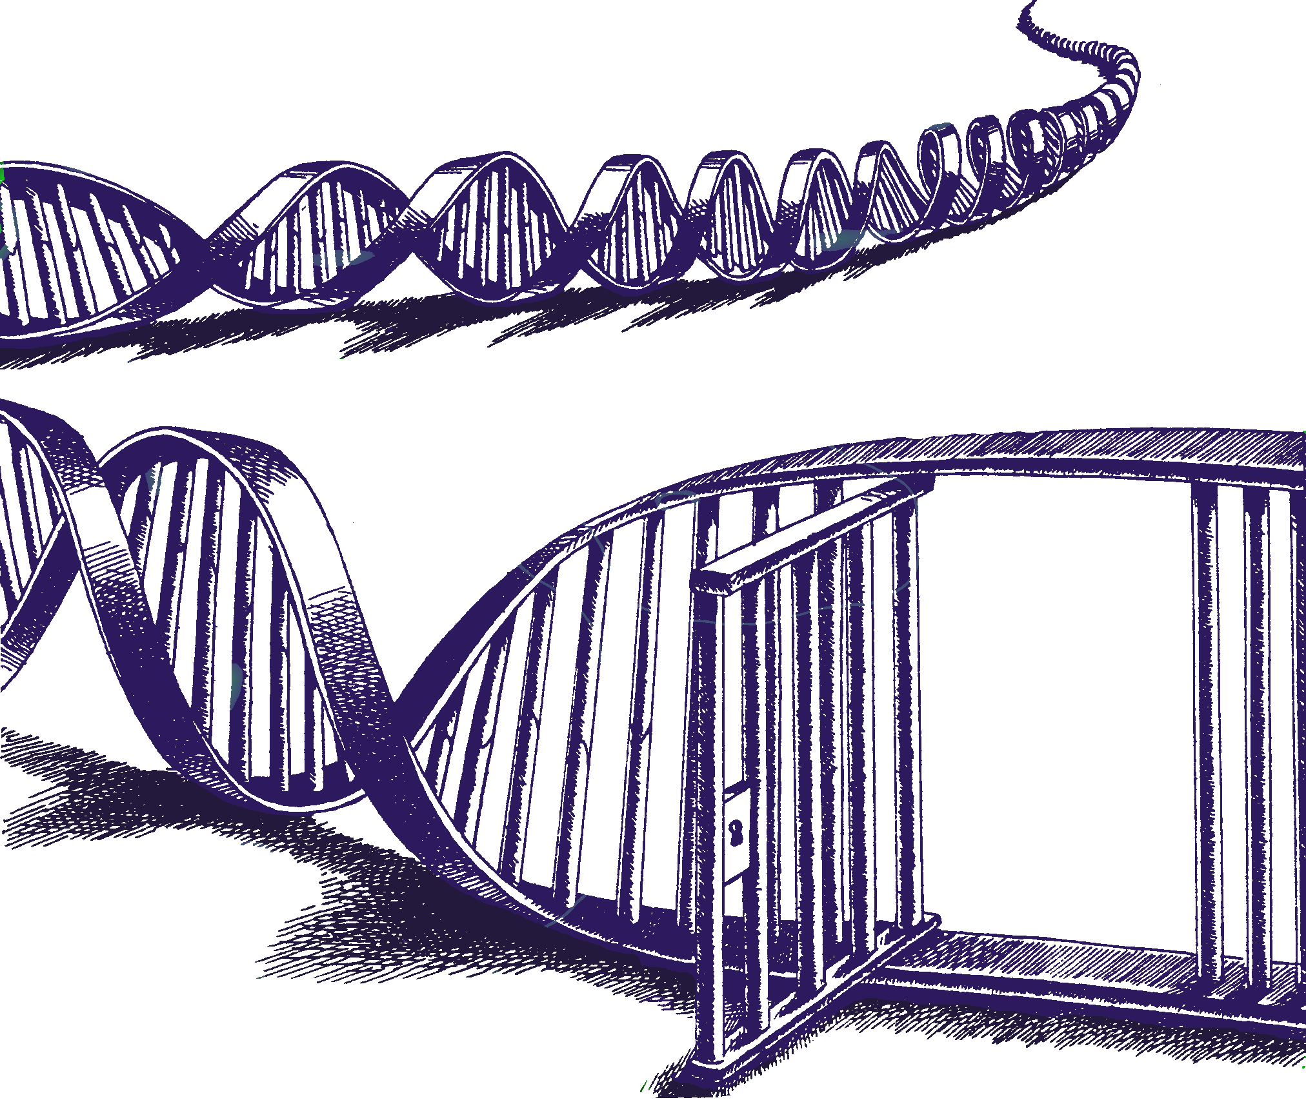
How to decide how many contributors in a mixture
Lesson from Mixture Solution™
Charles Brenner, Ph.D.
Purveyor of forensic mathematics, DNA∙VIEW®,
UC Berkeley Senior Human Rights Fellow
charles@dna-view.com +1 510 798 7139
http://dna-view.com
1:55-2:10 17 Feb 2017 B188
Notes:
Disclosures – DNA-VIEW is the name of my software and (informally) of my business.
Mixture Solution is a part of it that will get some mention in this generally academic talk.
In accord with the AAFS request, in case I happen to refer to competing programs STRmix/TrueAllele I should let you know that I have no stake.
Bode, a long-time user of my software, will be mentioned.

Slide 2
Two main ideas
Define the problem
  Define terms: “mixture”, “contributor”
Horizontal likelihood ratios
Pr(M|S?) Pr(M|S??) prosecution
Pr(M|??) Pr(M|???) defense
# of contributors
/
Vertical LR
Likelihood of
S + 1 unknown
to give M
M =mixture
S = suspect
? = unknown genotype

Slide 3
What’s the trick?
Define
  What is a mixture?
  What is a contributor?
Calculate likelihoods; directly (not via deconvolution) evaluate likelihoods Pr(Mixture | Hypothesis)
  Then all likelihood ratios including horizontal ones are immediately available.
  Whereas the deconvolution approach bypasses likelihoods, obtains only (vertical) likelihood ratios

Slide 4
Defining “mixture”
either of
  substance — mixture of biological material, DNA
  data — lists and numbers (typically an annotated EPG) obtained from processing mixture substance.
Software analyzes mixture data.

Slide 5
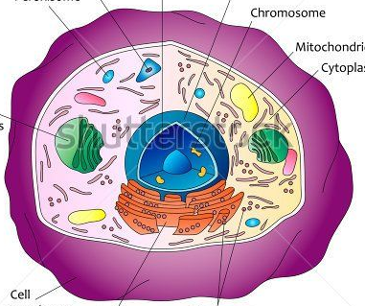
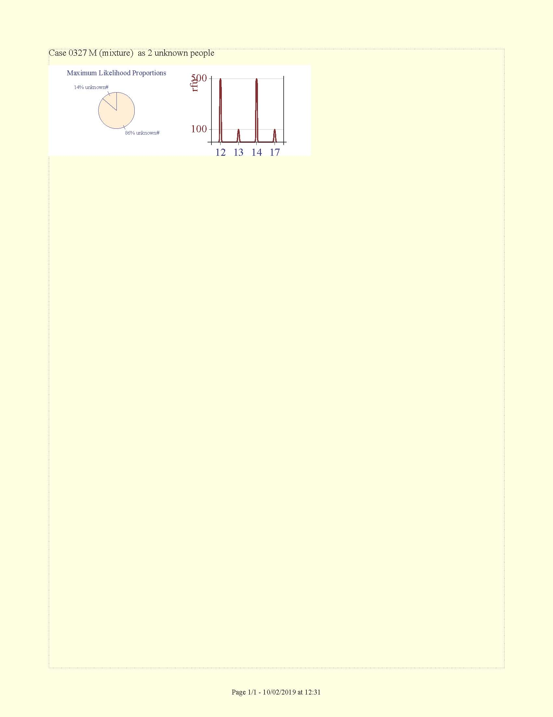
What is a mixture?
Biological material, i.e. DNA, or cells? (“goo”)
  “Ground truth”
Or information? (“data”)
# contributors is a property of the data, not of the goo.
Hence our concern is with Mixture data
Mixture goo
Mixture data
Detection threshold
2-person mixture
1-person mixture

Slide 6
What is a contributor?
ideas consistent with mixture=goo:
  Someone responsible for significant fluorescence?
    Vague. Hence not suitable for computation.
  Someone responsible for at least 1 cell? 1 photon of fluorescence?
    Bright line definitions – good. But impractical.
Consistent with mixture=data:
  “Contributor” is a DNA profile (known or unknown) whose participation helps to explain the mixture.
(hopeless)

Slide 7
Why “decide # of contributors”?
Programs make a different computation according to the number
Many programs require the number as input:
  MCMC: STRmix™, TrueAllele ®, EuroForMix
  LRmix, Lab Retriever
(Not Mixture Solution™ though)
The number matters to the result, sometimes a lot.

Slide 8
How “decide # of contributors”?
Historically
  Count alleles
  Eyeball
  Neural network/blackbox (Marciano/Adelman)
None claim to be accurate
Mixture Solution approach
  calculate

Slide 9
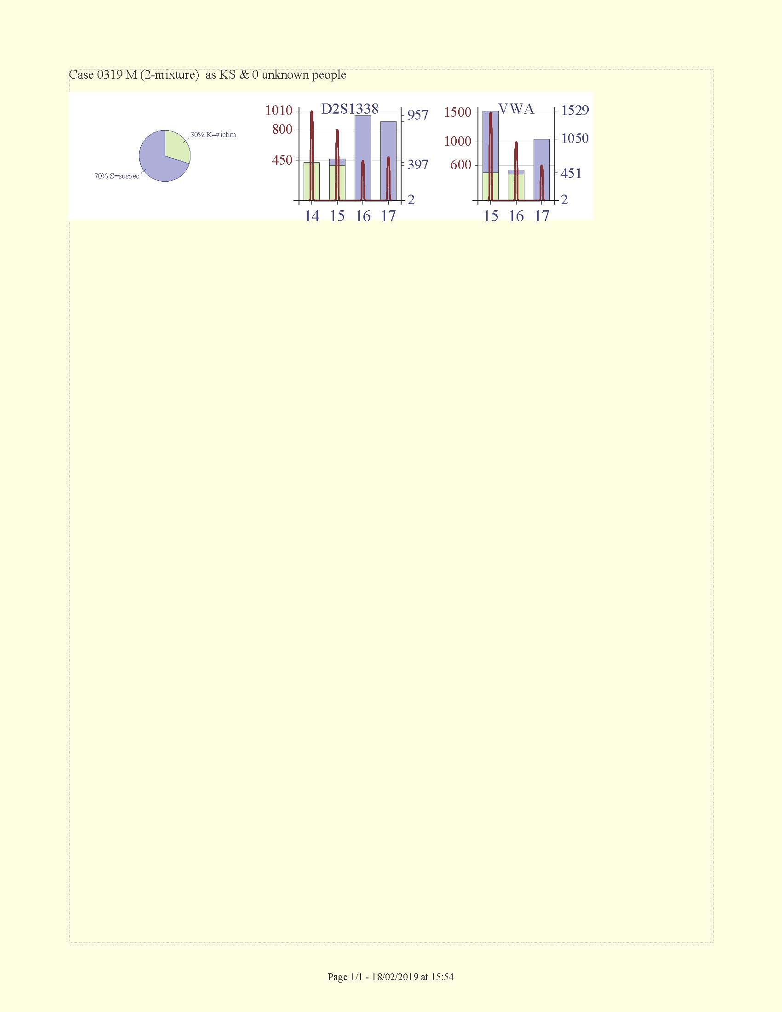
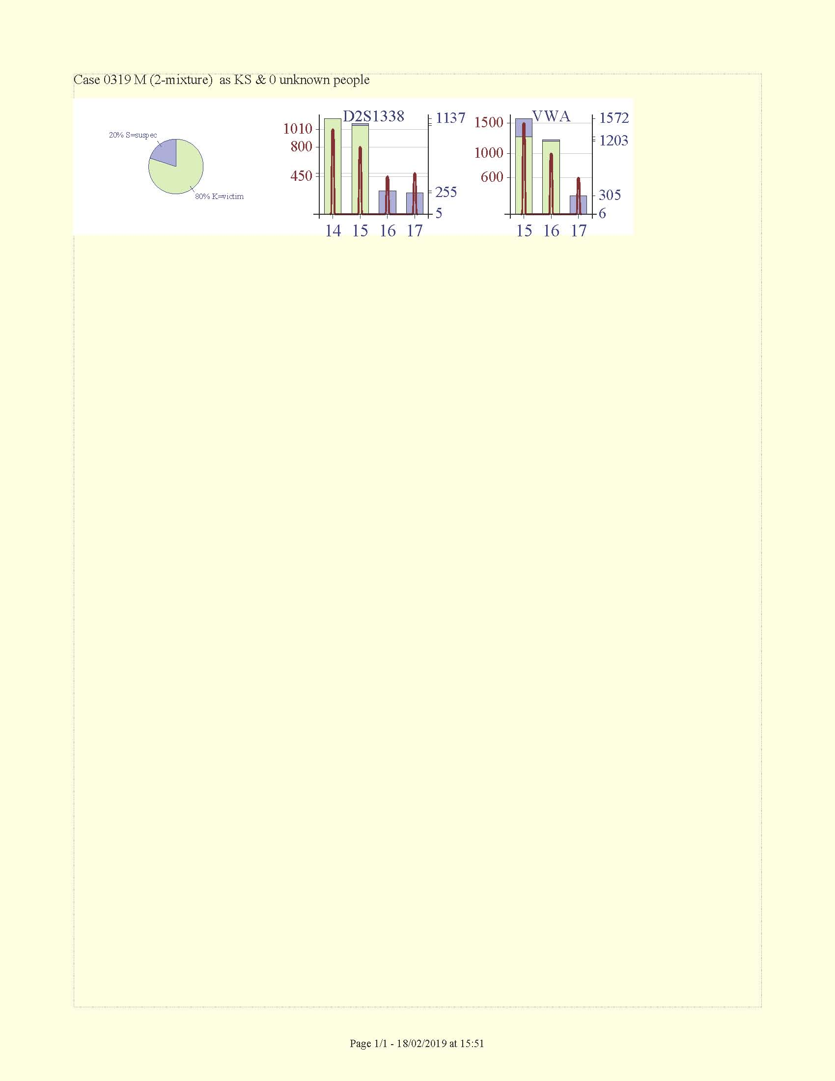
“Direct” Likelihood calculation explained by example.
L_{M}(KS) = Pr(M | 2 person hypothesis KS)
Pr(M|30%K, 70%S) = 0.000…
Pr(M|80%K, 20%S) = 0.087.
Pr(M|KS) obtained by calculating all proportions & averaging.
(Omitted: 2 slides extending calculation to unknowns, drop in/out, etc.)
}
Likelihood is penalized according to the expected vs observed misfit.
30% K
70% S
S
K
S
K
S
K
20% S
}
80% K

Slide 10
A simple mixture case 127
LR_{n} = LR(Hp vs Hd, n person total).
Maybe n =2 (Hp, prosecution hypothesis, is Suspect+Victim).
But increasing n (adding unknowns) always decreases LR_{n}
Stopping at what n is fair to the defense? Never?
Stop at best Hp … n=2,
and at best Hd … n=2.
Likelihood Ratios (=evidence against Suspect)
Hp likelihoods
LR₂
LR₅
Likelihood
Hd likelihoods
Notes:
Hp likelihood means numerator of the LR. Hd likelihood means the denominator.
“best” Hp or Hd means largest likelihood, i.e. p & d each choose the hypothesis that best supports their position.

Slide 11
Matrix of Likelihoods case 5001
Pr(M|KS 3pers) | Pr(M|KS 4pers) | Pr(M|KS 5pers)
Pr(M|K 3pers) | Pr(M|K 4pers) | Pr(M|K 5pers)
LR= L₄/L₅ =100000/15000=7
(relative) Likelihood
(=10^{x}·Pr)
Horizontal (inter-n) Likelihood Ratio
1000000
5600
Weight-of-evidence LR
LR= / = 1000000/5600 = 178,
or LR= (ave L(Hp)) / (ave LR(Hd))
= 390000 / 2100 = 184

Slide 12
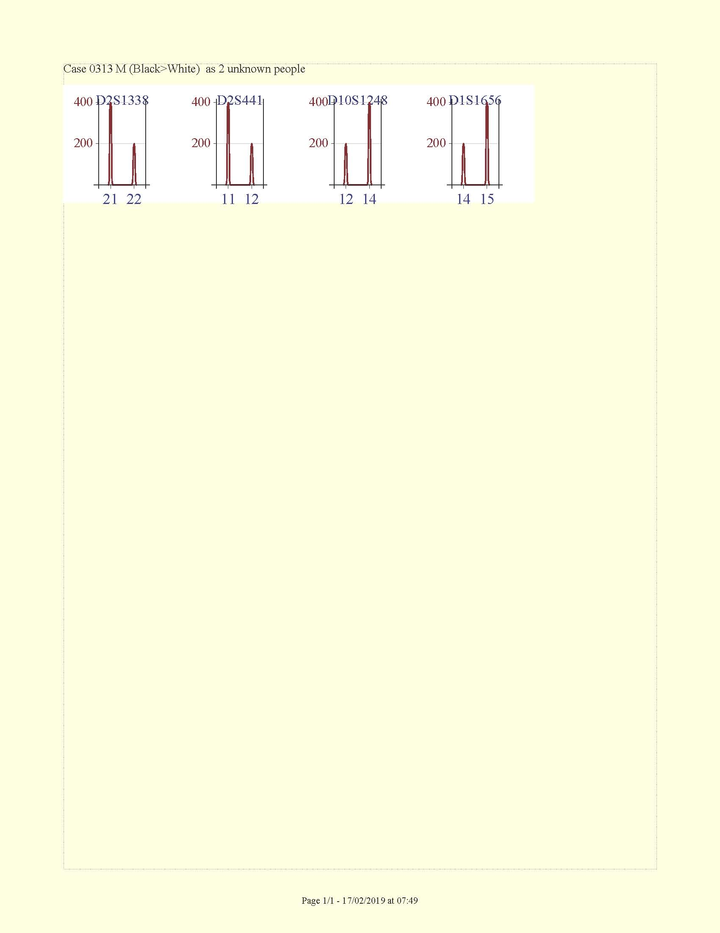
Context affects # of contributors
S
S
Example 1
S
# of contributors must exceed 2 or can =2 depending on reference zygosity (or reference absent).
from Biedermann et al, Law, Prob, Risk 2011
19.2 23 24 25
FGA
19.2 23 24 25
FGA
Alleles common in AfrAm pop’n makes 2nd contributor more plausible than extreme PHR.
Example 2
AfrAm, 2 person
Caucasian, 1 person

Slide 13
Background on “# of contributors”
Analysis & interpretation of mixed stains (Clayton … 1998 FSInt)
  [to begin] “identify the # of contributors to a mixture”
Mixture[s] when the # of contributors cannot be agreed (Brenner, Fimmers, Baur … 1996 IJLM)
[ISFG] Recommendations on the interpretation of mixtures (Gill, Brenner, Buckleton … 2006 FSInt)
  The number of contributors under H_{p} and H_{d} may be different.

Slide 14
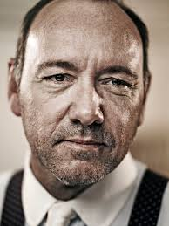

Differing #’s?
The number of contributors under H_{p} and H_{d} may be different.
Allow defense to choose its defense H_{d} in its self-interest.
H_{p} = suspect
Allow prosecution to choose H_{p} in its self-interest.
H_{d} = 2 unknowns

Slide 15
Implication of “mixture”=data
“Ground truth” describes mixture substance.
  has limited relevance to mixture data.
Software that estimates number of contributors is not right or wrong according to whether it agrees with ground truth.
  From mixture substance as deposited DNA to the final version of mixture data is a long trip.
  It’s not a paradox when the best possible, most correct, analysis of mixture data, differs from the ground truth about something else.

Slide 16

Wrap up
Think of mixture as data
  Not goo. Not “ground truth.”
Calculate likelihoods rather than deconvolving
  Permits “horizontal” likelihood ratios
    which compare contributor #’s
  Permits strength of evidence
    as “vertical” LR (as does deconvolving)
    also diagonal LR – can be critical, otherwise good to eliminate
  Calculate, don’t guess, exactly appropriate # of contributors.
Likelihood ratio of #s of contributors

Slide 17
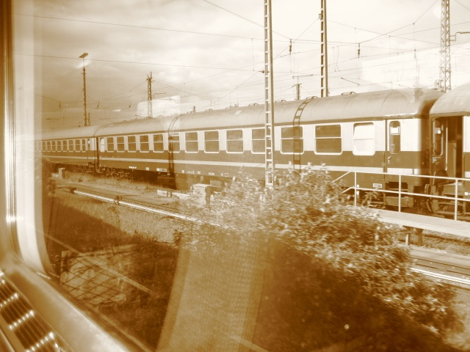
charles@dna-view.com
http://dna-view.com
☎510 798 7139
The end
This work received no support from the NIJ, IMF, World Bank, Bill and Melinda Gates, or the Ford Foundation. Even Queen Isabella of Spain (usually a soft touch) wouldn’t pitch in.

Slide 18
Using likelihoods
3pers 4pers 5pers
Prosecution Hp
M=KS+unknowns
Horizontal likelihood ratios
7
58
3
Vertical likelihood ratios
1400
180
Diagonal likelihood ratio
Defense Hd
M=K+unknowns
8
Horizontal likelihood ratio
3pers 4pers 5pers

Slide 19
Likelihood Ratios (LRs)
 |  | Defense (of S) hypotheses
 | LR Hp/Hd | K1,K2&1unk (3 pers) | K1,K2&2unk (4 pers) | K1,K2&0unk (2 pers)
Prosecution hypotheses | K1,K2,S&1unk (4 pers) | 2 | 120 | 10⁴⁵
 | K1,K2,S&0unk (3 pers) | 10⁻²¹ | 10⁻²⁰ | 10²⁴
!
That’s LR=10²¹ favoring defense!
Notes:
# contributors matters. If insist on same number, which number?

Slide 20
How to calculate a likelihood Pr(M|references, n)
Let an “atomic” hypothesis H(n, {G}, c) explanation of a mixture be of the form
  n = fixed number of contributors, i.e. n=2.
  {G} = n specified genotypes, i.e. G₁, G₂
  c = n fixed contribution proportions, i.e. {75%, 25%)
Example: (show 2-locus 2-contrib rectangle plot). Evaluate Pr(M|H) per gamma model
Compute & average many atomic L’s.

